Slide 1

School Management System

Slide 2
Contents
Introduction
About Developers
How the Program will work
Software Development Process
Visual Basic
Training
Final Product
Other Suggestions

Slide 3
Introduction
As we all know that School Management System is necessary for every school, college and educational institutions.
Mostly in many school, college and educational institutions registers are considered to be used as it is lengthy and hard to retrieve data.
So, we decided to create a School Management System which will make our work easier and faster.
It is a multi-user system and can be used by hundred of users.

Slide 4
Visual Basic
Visual Basic is a high level programming language involved from the earlier DOS Version called BASIC. BASIC means Beginner All Purpose Symbolic Instruction Code.
A fairly easy programming language to learn.
Different Software companies produced different version of BASIC, Such as Microsoft QBASIC, QUICKBASIC, GWBASIC, IBM BASICA and so on.
Visual and Event driven programming language.
Graphical Environment.

Slide 5
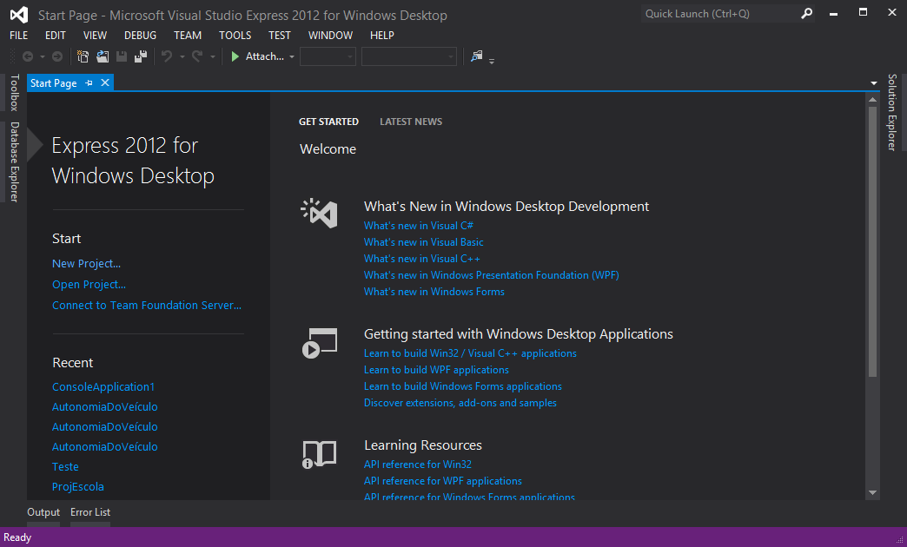
Visual Basic Software Interface

Slide 6
Software Development Process
Creating this software took us about 1 and a half months.
Internet helped us the most.
Our teachers supported us too .
3 of us (Twinkel, Khem Raj & Bibek) created this Software called “School Management System”.

Slide 7
Our teacher taught us little bit about it.
YouTube is the main source of help.
Some Others sites helped us too.
Training

Slide 8
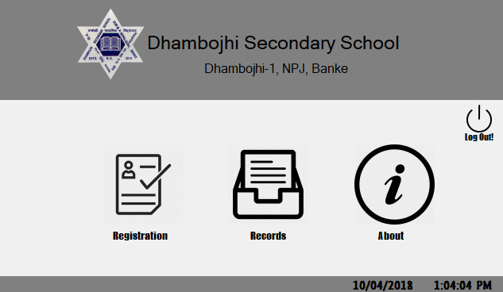
Final Product

